Slide 1
Reddit “Hot” Posts Scraper
Dale Deans, Julia Shen

Slide 2
Purpose & Goal
Purpose: Provide the content creation team with a more time efficient way of finding out what topics are trending.
Focus: Subreddits’ moderated forum setting eliminate the worry of encountering irrelevant or random posts.
Goal: To be able to input a given subreddit name and desired number of posts into the tool and get back the titles of the top “hot” posts as well as data relating to the comments under each of those posts. The overall idea is for the tool to tell us what topics are trending as well as give context as to why they are trending.

Slide 3
BReakdown of code
Libraries:
PRAW (Python Reddit API Wrapper)
Pandas
Matplotlib
World cloud
RE (Regular Expression)
NLTK (punkt, stopwords, etc)

Slide 4
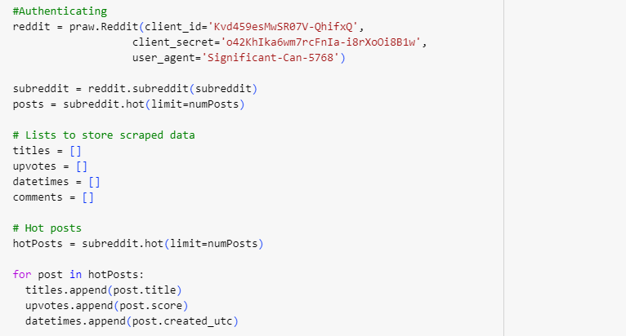
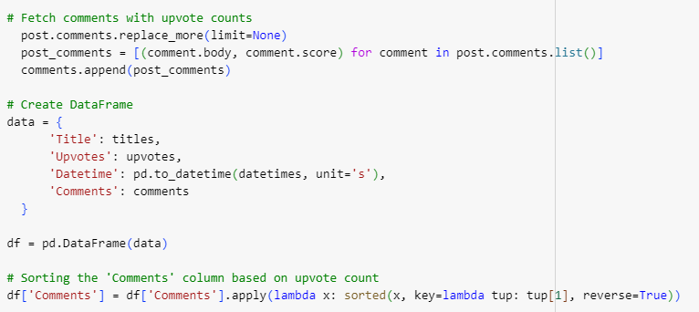
Scraping Portion

Slide 5
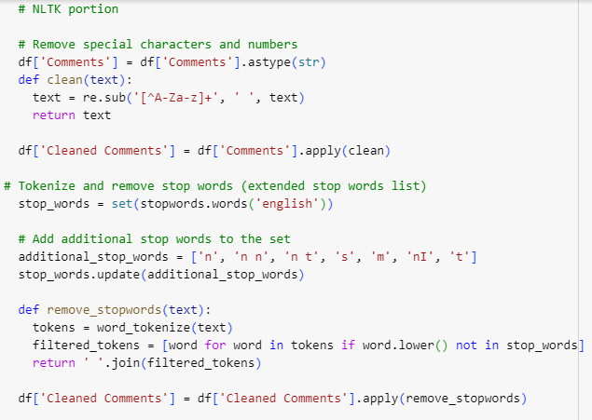
NLTK portion

Slide 6
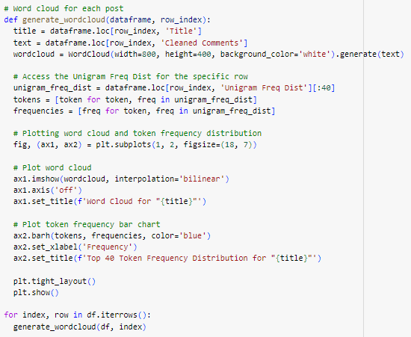
Word cloud and frequency distribution visuals code

Slide 7
What the tool Returns
The tool takes a given subreddit name and desired number of posts and returns the following:
Titles of hot posts
Top comments per hot post
Top comments by upvote score
Top comments by replies
Word Clouds and frequency distribution charts reflecting the most frequent words in each hot post’s total comments

Slide 8
Demo

Slide 9
Potential Obstacles
Random 1-2 letter strings appearing in the word clouds and frequency distribution charts due to them not being accounted from in stop words list. We noticed certain text formats and foreign language can cause these irregular strings to show up. So far, we’ve only accounted for what we’ve come across.
As the tool is currently constructed, reddit is solely responsible content moderation so if there is a random post in the top “hot” posts, the tool cannot filter it out.

Slide 10
Project Continued
After getting some input from the content creation team, we have expanded the range of the tool to scrape for more than just “hot” posts. The tool can now also scrape for “rising”, “top”, and “new” posts.

Slide 11
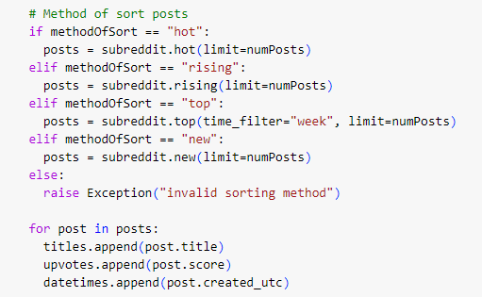
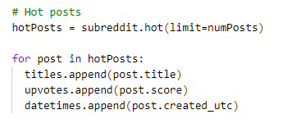
Code comparison
Before After

Slide 12
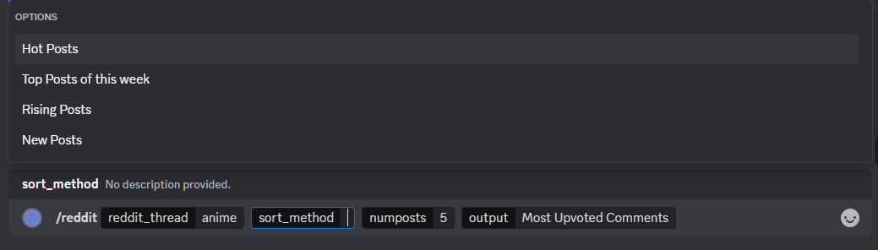
Preview of discord bot user interface
A look at the new discord bot reddit command with the sort method included:

